Slide 1
Digital Electronics
Instructors: Dr. Alfred Uwitonze
Placide Rwego Mucyo

Slide 2
Lecture 1
Introductory digital concepts
Development and application of digital technology
Analog signal and digital signal
Analog circuits and digital circuits
Digital technology advantages

Slide 3
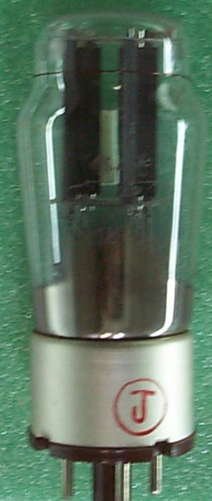
Development of digital technology
A crude mechanical computation device was developed by Charles Babbage in 1830s.
The first electromechanical digital computer was built in 1944.
The electronic computer was established in 1946 with vacuum-tube circuit.
The first transistor was born in 1948.
The computer was manufactured in 1954 with 800 transistors.
Vacuum tube

Slide 4
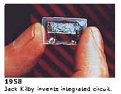
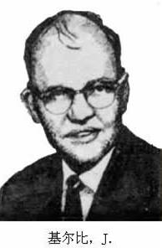
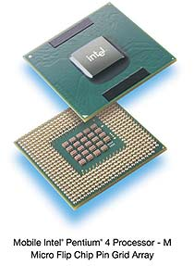
Development of digital technology
The first integrate circuit was executed in 1958.
IC technology was developing quickly from that time.
SSI, MSI, LSI, VLSI, PLD and ASIC, etc.

Slide 5
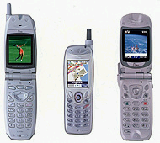

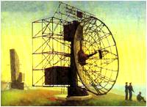
Application of digital technology
Communication systems
Radar
Navigation and guidance systems

Slide 6
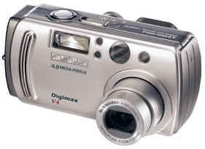
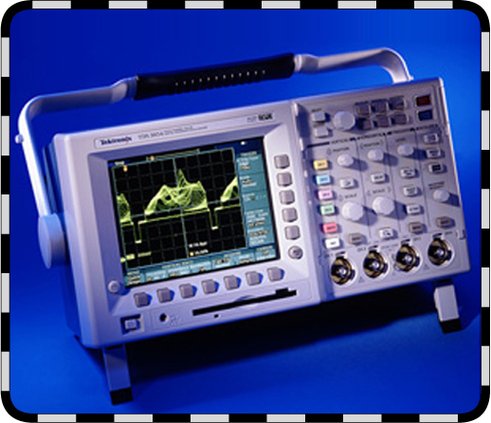
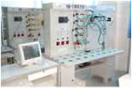
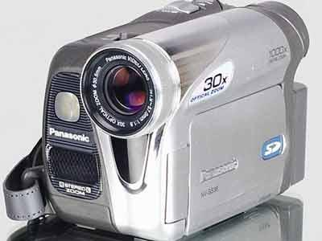
Application of digital technology
Industrial process control
Intelligence instrument
Digital camera and vidicon

Slide 7
Next item what we’ll talk
Development and application of digital technology
Analog signal and digital signal
Analog circuits and digital circuits
Digital technology advantage

Slide 8
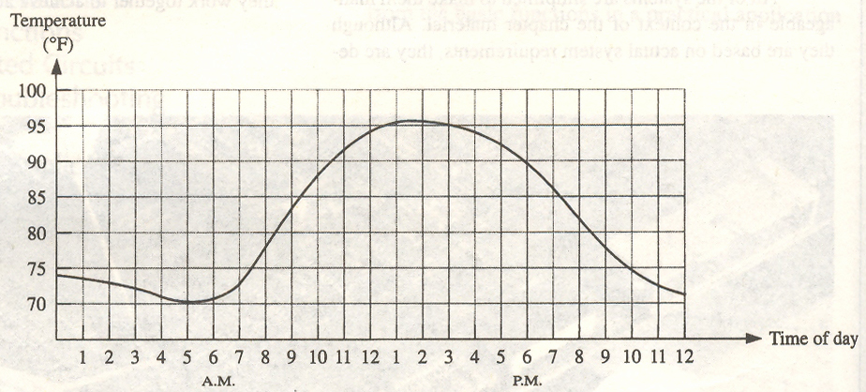
Analog signal and digital signal
Analog signals
An analog signal is the signal that its values and time are continuous.
78.175425… extending to infinite digits
representative of analog signal

Slide 9
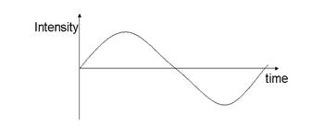
Analog signal and digital signal
An analog signal can be depicted using three properties:
Amplitude
Phase
Frequency
Amplitude- Amplitude is the property of analog signal that varies accordingly as it moves .The maximum amplitude of a signal is the maximum distance from horizontal axis to the vertical axis depicting the analog signal.
Amplitude of Analog Signal

Slide 10
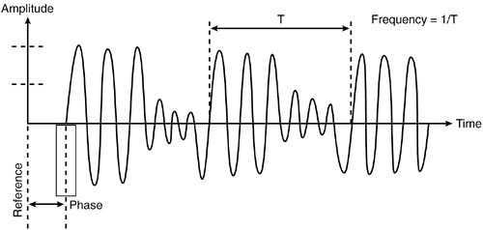
Analog signal and digital signal
Frequency - The number of cycles completed by wave form per unit time is defined to be frequency.
Frequency = 1/ time period

Slide 11
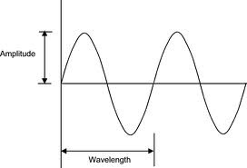
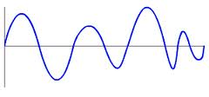
Analog signal and digital signal
Analog signal is of two types :
-Synchronous Analog Signal
-Asynchronous Analog Signal
Synchronous Analog Signal -
A synchronous analog signal is the one which is which repeats its pattern over time over and over again.
i.e is a function of type "sin(wt)" it forms a continous pattern attaining same maximum and minimum amplitute over and over again over a period of time
Asynchronous Analog Signal - An asynchronous analog signal is one which does not form a continuous pattern of wave.
synchronous analog signal
Asynchronous analog signal

Slide 12
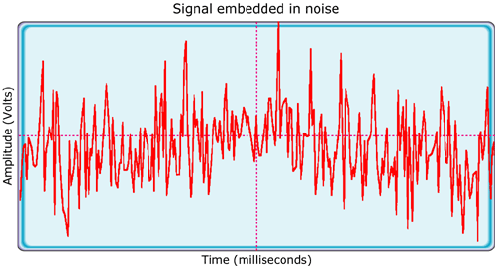
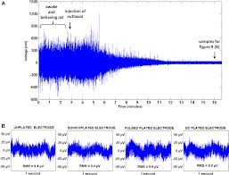
Analog signal and digital signal
Noise -random unwanted variation.
As the signal is copied and re-copied, or transmitted over long distances, these apparently random variations become dominant.
The effects of noise create signal loss and distortion. This is impossible to recover
Thermal noise in analog Signal

Slide 13
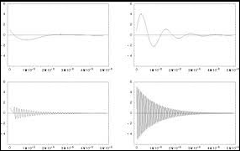
Analog signal and digital signal
Attenuation - It is loss of energy in the signal as it is transmitted from the source in destination.

Slide 14
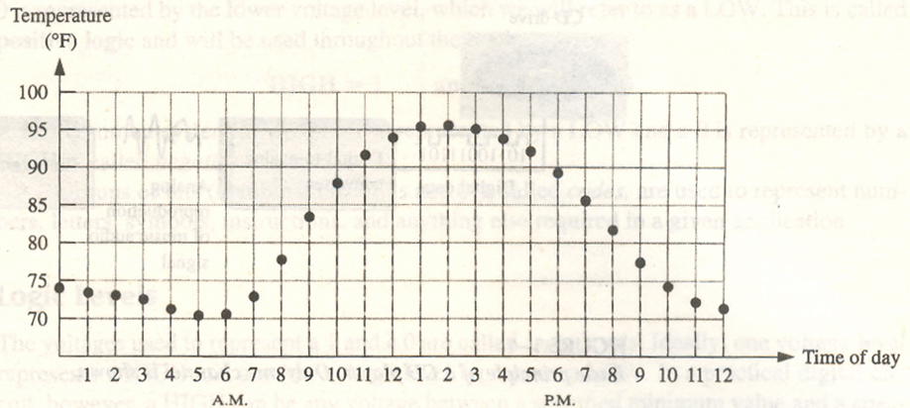
Analog signals and digital signals
Digital signals
A digital signal is the signal that its values and the time are discrete.
Continuous time → discrete time by sampling
Only 78.2
finite digits
Infinite digits → finite digits by quantization

Slide 15
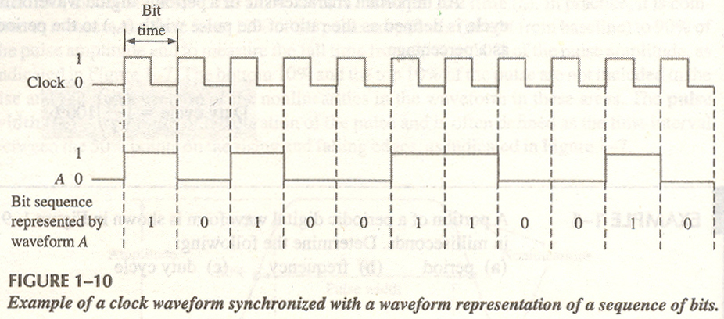
Analog signals and digital signals
Binary digital signals
There are two digits in binary system, 0 and 1.

Slide 16
Next item what we’ll talk
Development and application of digital technology
Analog signal and digital signal
Analog circuits and digital circuits
Digital technology advantage

Slide 17
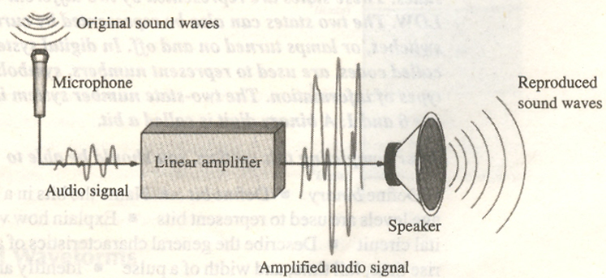
Analog circuits and digital circuits
Analog circuits
An analog circuit is the circuit which can process the analog signals.

Slide 18
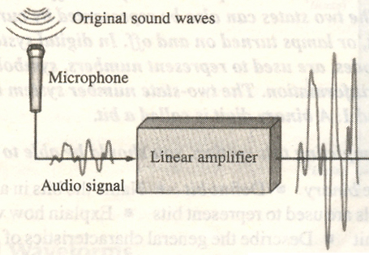


Analog circuits and digital circuits
Digital circuits
A digital circuit is the circuit which can process the digital signals.
CD rom
Mp3
(wma)
Analog to digital converter
Encoder
Memory
Analog circuit
Mix circuit of Analog and digital
Digital circuits

Slide 19
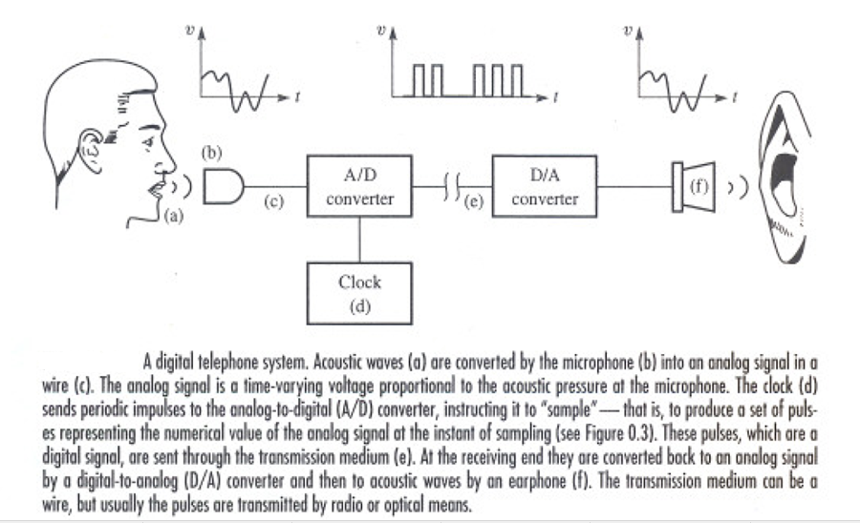
Digital telephone system

Slide 20
Next item what we’ll talk
Development and application of digital technology
Analog signal and digital signal
Analog circuits and digital circuits
Digital technology advantage

Slide 21
Digital technology advantage
Affected less by noise and more reliable
More convenient process and storage
Designed easier
Secrecy stronger
More and more the electrical systems are consist of digitals.
But it doesn’t indicate that the analog circuits will be instead of digital circuits entirely. Because the most of signals in nature are analog form.

Slide 22
Simple Quiz
What do you understand by Digital electronics? at least give two application?
Differentiate analogue signal to Digital signal give examples
Describe in brief advantage and Disadvantage of Digital Technology over analogue

Slide 23
Simple Quiz (Solution)
What do you understand by Digital electronics? at least give two application?
Digital Electronics is an Electronics that uses binary numbers of 1 and 0 to represent information. Digital electronics are based on what are called logic circuits, which open or close based on the presence of an electronic pulse. i.e: digital clock, microcontrollers and CPUs.

Slide 24
Simple Quiz (Solution)
Differentiate analogue signal to Digital signal give examples
An analog signal transmits data in the form of wave whereas, a digital signal transmits the data in the binary form. The best example of an analog signal is a human voice, and the best example of a digital signal is the transmission of data in a computer.

Slide 25
Simple Quiz (Solution)
Describe in brief advantage and Disadvantage of Digital Technology over analogue
Advantages of digital circuit:
-Immunity to transmission noise and interference.
-Easy to implement
-security, you can add excellent encryption on transmission.
-Cheaper than analog in specific cases
Disadvantages
-Synchronization is necessary for digital systems (between transmission and receiver clocks)
-Digital transmission systems are not compatible to older analog transmission systems

